Slide 1
OROS
An Autonomous Agentic Market Analyst — a research prototype of robo-advisory's next generation
It scans 500 stocks nightly, builds risk-sized simulated portfolios, explains every decision on YouTube twice a day, and grades its own record in public — the advisor that shows its work.
JP Romero · Fordham MSAIB · July 29, 2026
Research under Prof. Yi Tang's Stock Prediction initiative — methods and results open to review by finance quant faculty and students
Advisors: Dr. Yilu Zhou · Prof. Markus Ettl · Prof. Yi Tang
Notes:
50 seconds. Open with the show of hands: who has a financial advisor? Almost nobody. Who has a brokerage app? Everyone. That gap is where this capstone lives. Then the one-liner: an AI agent team that runs a research desk by itself and publishes its record, win or lose. Frame as research: journaled, auditable, simulated money only.

Slide 2
SECTIONS 1–2 · THE CORE BUSINESS PROBLEM
Human-Led Financial Decision-Making Is Expensive, Slow, and Emotional
TRADITIONAL WEALTH MANAGEMENT
→ solved by →
ROBO-ADVISORS & AGENTIC AI
high fees · human bias · slow execution
low cost · algorithmic logic · real-time autonomy
The fundamental problem that robo-advisors and agentic trading exist to solve is the inefficiency, cost, and emotional bias of human-led financial decision-making. Traditional wealth management needs $100,000-plus minimums to justify an advisor's time, and passes a 1–2% annual fee down to the client. Human investors panic-sell crashes, overbuy hype, and can process only a fraction of the market's data before fatigue sets in — while markets themselves move in milliseconds, far faster than human analysis and manual order routing. And hand-tailoring rebalancing, risk profiles, and tax optimization for thousands of individual accounts is humanly impossible: the mass-customization paradox.
Automation answers each of these at once: portfolios served profitably at $0–$500 minimums, management fees near 0.25%, logic-based strategies running 24/7 without emotion or cognitive limits, and personalization delivered at machine scale through daily automated account reviews.
The opportunity: $1T+ already managed · $18.5B→$67.8B by 2031 (29.6% CAGR). Cost is solved; conversation is not. That is OROS's gap.
Sources: cepr.org (Skiera robo-advisers) · researchgate.net robo-advisor design · condorcapital.com Robo Report · truthifi.com · tradealgo.com · investor.gov · investopedia.com · mordorintelligence.com
OROS · Fordham MSAIB Capstone · simulated paper trading · educational, not financial advice
Notes:
90 seconds. Read the room the flow diagram first, then speak the paragraph naturally — it is written to be said aloud: minimums, fees, emotion, speed, and the mass-customization paradox, then automation's answer to all five. Land the gold line: a trillion dollars proves cost is solved — nobody shows their reasoning, so conversation is not. And OROS's own position in this industry is deliberate: it proposes and journals; it never executes.

Slide 3
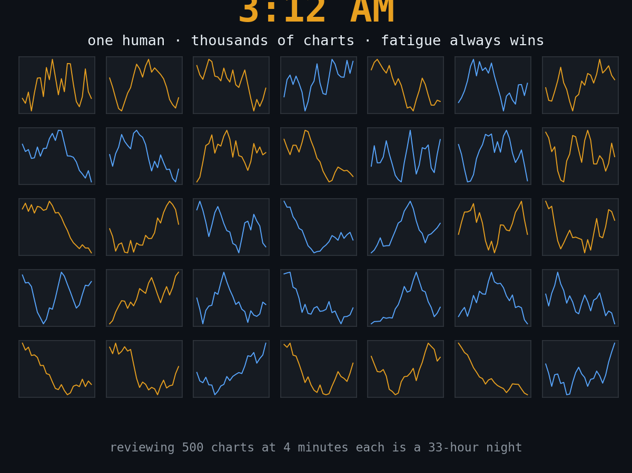
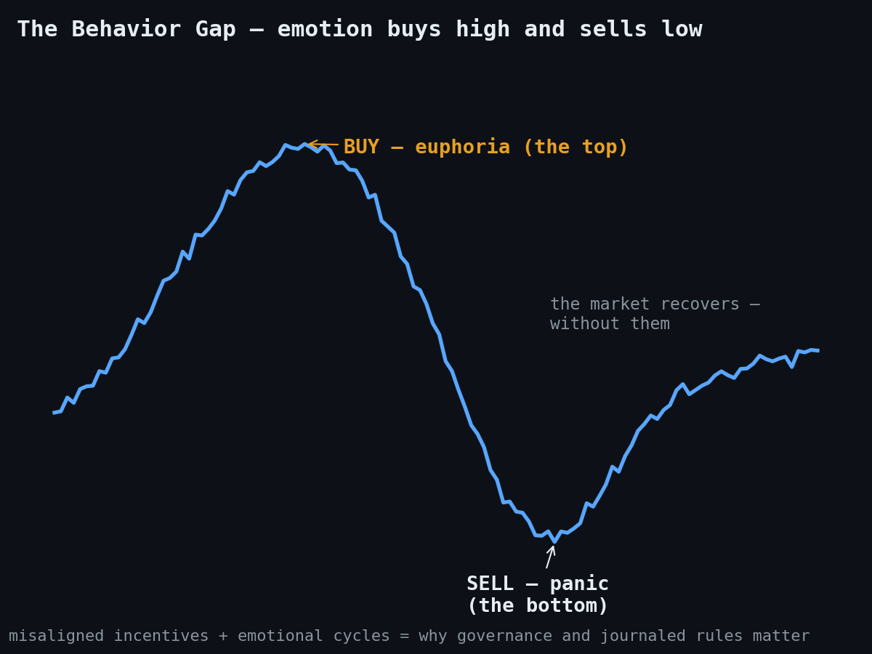
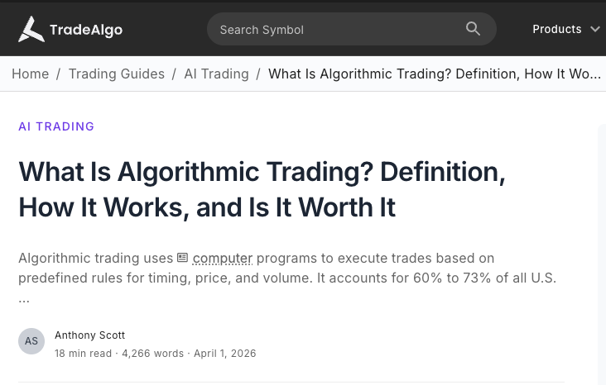
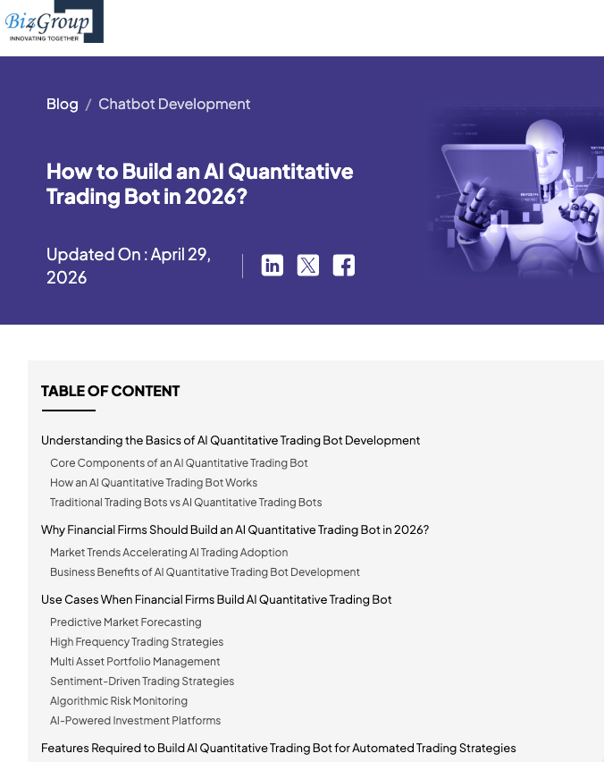
SECTIONS 1–2 · THE HUMAN COST
Why This Problem Is Real — and Already Being Automated
Algorithmic trading already accounts for 60–73% of ALL U.S. equity volume (TradeAlgo) — and the industry is racing to build more (Biz4Group, 2026).
The machines already trade most of the market. The humans left behind burn out at 3 AM or sell the panic — and no one shows them the reasoning. Transparency is not a feature request; it is governance.
60–73% of U.S. equity volume is already algorithmic (TradeAlgo, 2026) · the build-a-bot industry is booming (Biz4Group)
Sources: tradealgo.com · biz4group.com · illustrations: OROS (original)
OROS · Fordham MSAIB Capstone · simulated paper trading · educational, not financial advice
Notes:
45 seconds. All pictures, minimal reading. Left: the burnout — one human, thousands of charts, 3 AM; reviewing 500 charts manually is a 33-hour night. Center: the behavior gap — emotion buys the euphoric top and sells the panic bottom, and the market recovers without them; misaligned incentives and emotional cycles are exactly why governance and journaled rules matter. Right: the punchline stats — 60 to 73 percent of ALL U.S. equity volume is already algorithmic, and the industry is racing to build more bots. The machines already run the market; the question is whether anyone shows their reasoning. That is the governance gap OROS answers with journals.

Slide 4
SECTION 3 · CORE STAKEHOLDERS
Builders, Users, and Regulators — the Whole Ecosystem Has Skin in This
REGULATORS — SEC · FINRA · Compliance
market integrity · algorithmic fairness · AI transparency
↓
RETAIL & INSTITUTIONAL INVESTORS
FINANCIAL FIRMS — BANKS & WEALTH
TECH BUILDERS — AI, DATA, SECURITY
the capital — low fees, inclusion, alpha
→
the service — scale, lower OpEx, new roles
←
the machinery — models, feeds, safeguards
The stakeholders span the whole financial ecosystem — those who provide the capital, those who serve it, those who build the machinery, and those who police it. Retail investors want low-fee management and inclusion without six-figure minimums, while hedge funds and pension managers want alpha and cheaper execution. Wealth firms and banks gain scale and lower operating costs — as traditional advisors shift from portfolio construction toward coaching and estate planning. Behind them, FinTech engineers maintain the models and safeguards, data providers like Bloomberg supply the feeds, and cybersecurity teams protect the APIs from manipulation. Above it all, the SEC and FINRA — plus internal risk officers — enforce fairness, transparency, and fiduciary duty, watching for breached thresholds and flash crashes.
OROS compresses this map into one transparent system: investor-facing doors (video, report, computation, chat), builder-grade journals — and a regulator's dream: every decision logged, disclosed, and never executed.
Sources: academic.oup.com (Current Legal Problems) · sec.gov · hedgefundalpha.com · investmentnews.com (SEC/UBS YES case) · siskolegal.com
OROS · Fordham MSAIB Capstone · simulated paper trading · educational, not financial advice
Notes:
60 seconds. Walk the diagram: regulators above, three pillars below — capital, service, machinery. Then the paragraph, naturally. Two nuances for the committee: traditional advisors are not eliminated — their role shifts to coaching and complex planning; and the governance tier is not decoration — the SEC/UBS YES-strategy case shows what happens when complex products lack transparency. Land the gold line: OROS gives investors four doors in, builders auditable journals, and regulators a system that logs everything and never executes. That is why 'proposes, never trades' is a design principle, not a limitation.

Slide 5
SECTION 4 · SOLUTION OVERVIEW
An Agent Team, Not a Model — 31 Agents, Three Tiers
DataAgent
prices · SEC XBRL · FRED · sentiment
THE SPECIALIST BENCH — 18 sector agents
REIT · Bank · Insurance · Energy · Utilities · Industrials · Defense · Semiconductors · Software · Tech · AI-Compute · Consumer · Healthcare · Pharma & MedDevice · Biotech · Infrastructure · Funds/ETF · Generic
RegimeAgent
the whole market's stage + VIX → risk appetite
ScannerAgent + Classifier
500 names staged nightly; each ticker routed to its sector specialist
RouterAgent + MemoryAgent
blends 8 strategy traditions; tilts toward what has WORKED (forward record)
Each reads its industry's own SEC filings with sector-specific tools — a REIT is graded on FFO, a bank on deposits, a biotech on its pipeline.
ConstructionAgent
selects and risk-sizes one concentrated book
RiskAgent — veto power
1.25%/name · 6% wallet · sector caps · earnings blackouts · throttle
RESEARCH VOICES — Chartist Strategist · Sentiment Analyst
DIALOGUE — Ask OROS · Script Assistant · Claude Scout
The Desk
renders, voices, publishes, emails — then grades itself at the close
The doctrine: agents nominate and narrate; deterministic arithmetic sizes every position. A hallucination cannot size a trade.
OROS · Fordham MSAIB Capstone · simulated paper trading · educational, not financial advice
Notes:
75 seconds. Correct count, three tiers: seven pipeline roles on the left run the daily loop; the right panel is the bench — EIGHTEEN sector specialists, each reading its industry's own SEC filings with sector-specific tools (a REIT graded on funds-from-operations, a bank on deposits, a biotech on its trial pipeline), routed by the Classifier; plus the research voices and the three dialogue agents. Thirty-one agents, one journaled truth. Close on the doctrine — the answer to the LLM-in-finance objection.

Slide 6
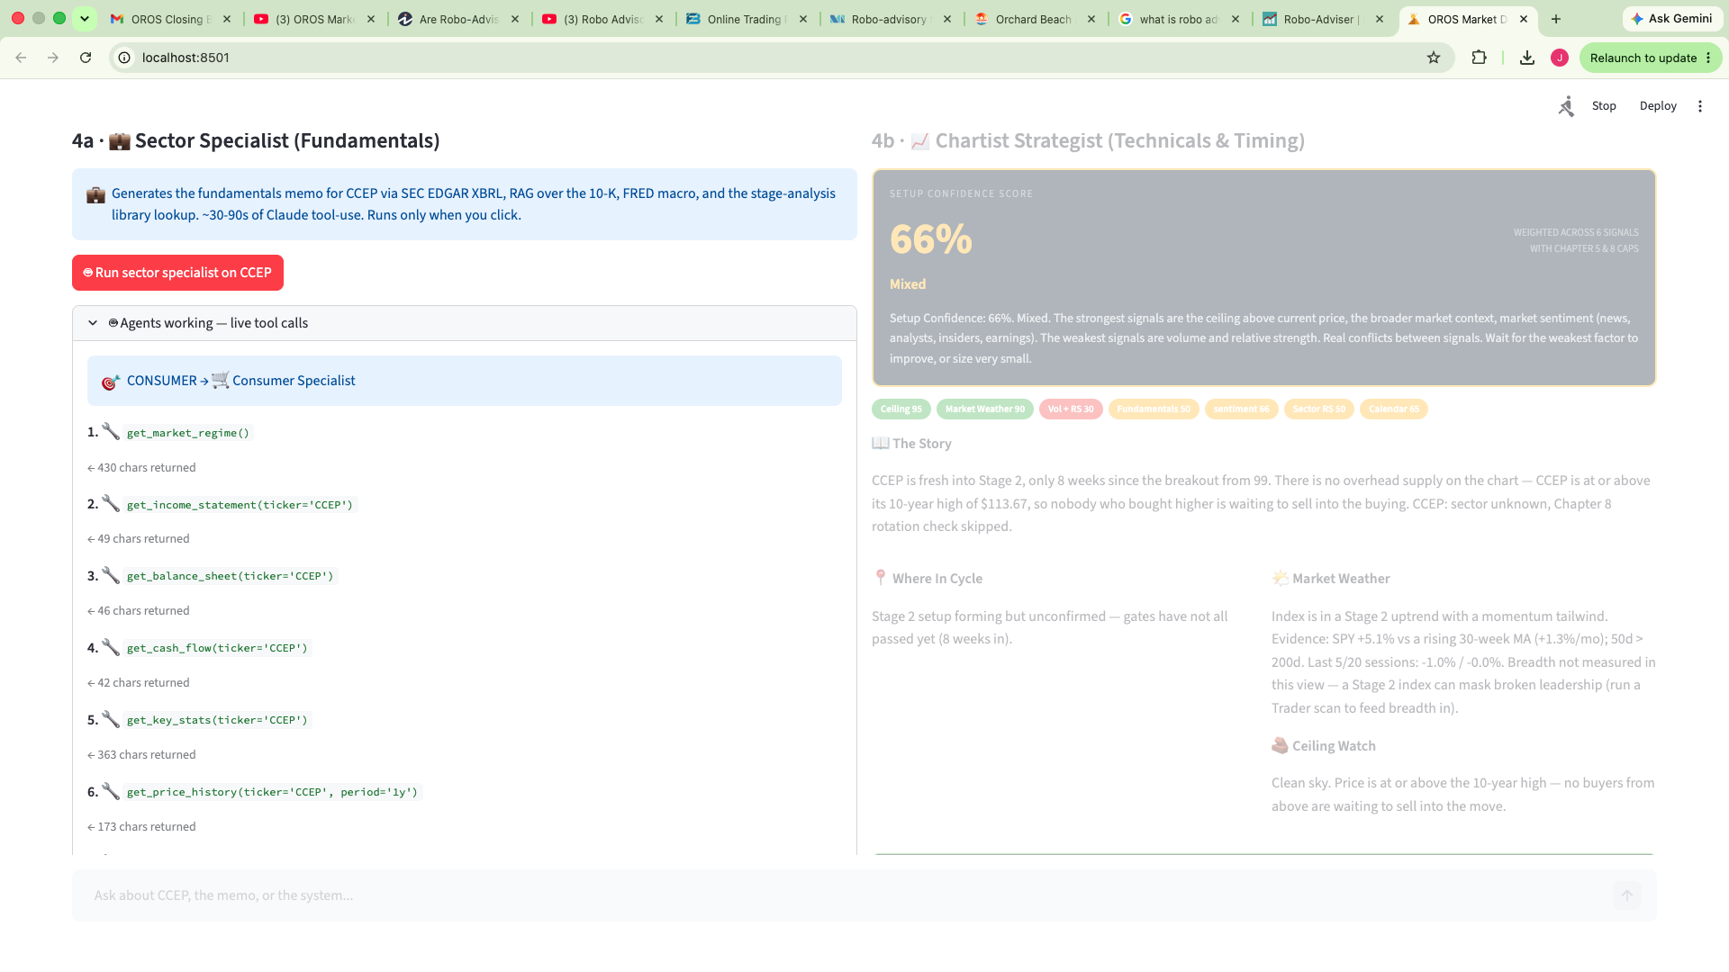
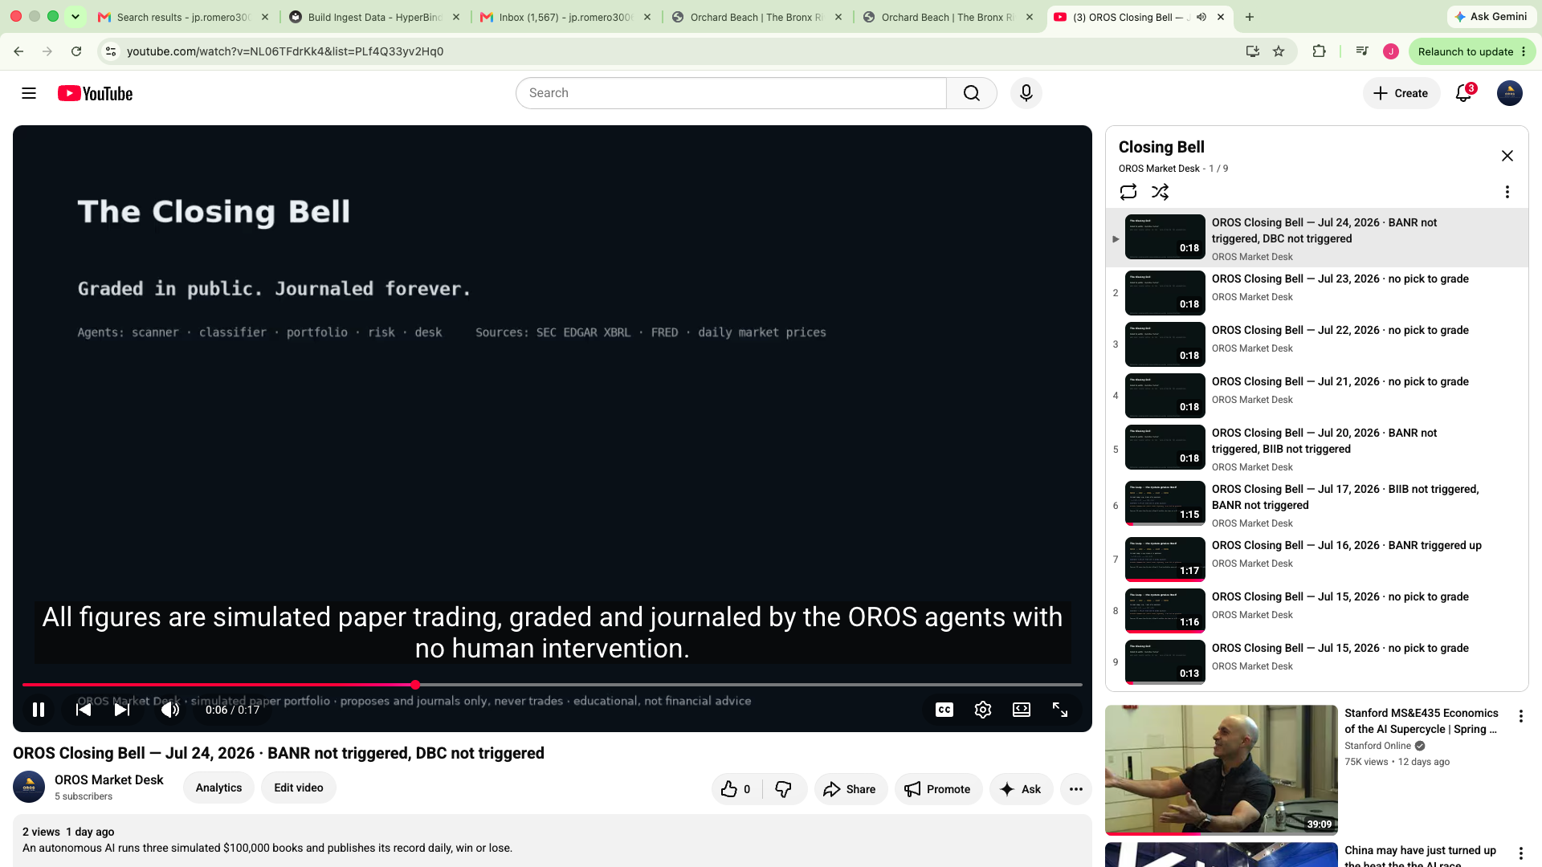
SECTION 4 · SOLUTION — TRANSPARENCY BY DESIGN
The Agents Work With the Door Open
Inside the app: the Sector Specialist's tool calls render LIVE — every SEC lookup, every claim, visible as the agent works.
Outside the app: the public channel — every conclusion broadcast, timestamped, wins and quiet days alike, no edits, no deletions.
Openness is the product's trust engine: the workflow is watchable inside, the record is auditable outside. A robo-advisor asks for trust; OROS manufactures it by exposure.
OROS · Fordham MSAIB Capstone · simulated paper trading · educational, not financial advice
Notes:
40 seconds. Two windows into the same honesty. Left: the agent workflow itself — when the Sector Specialist analyzes a company, its tool calls stream onto the screen: which SEC filing it pulled, which metric it computed, in order. Nothing happens behind a curtain. Right: the public channel — the same agents' conclusions broadcast twice a day, timestamped forever, including the days with nothing to say. Say the gold line slowly: a robo-advisor asks for trust; OROS manufactures it by exposure. Then hand off: now let me show you what those agents actually produce — the scanner.

Slide 7
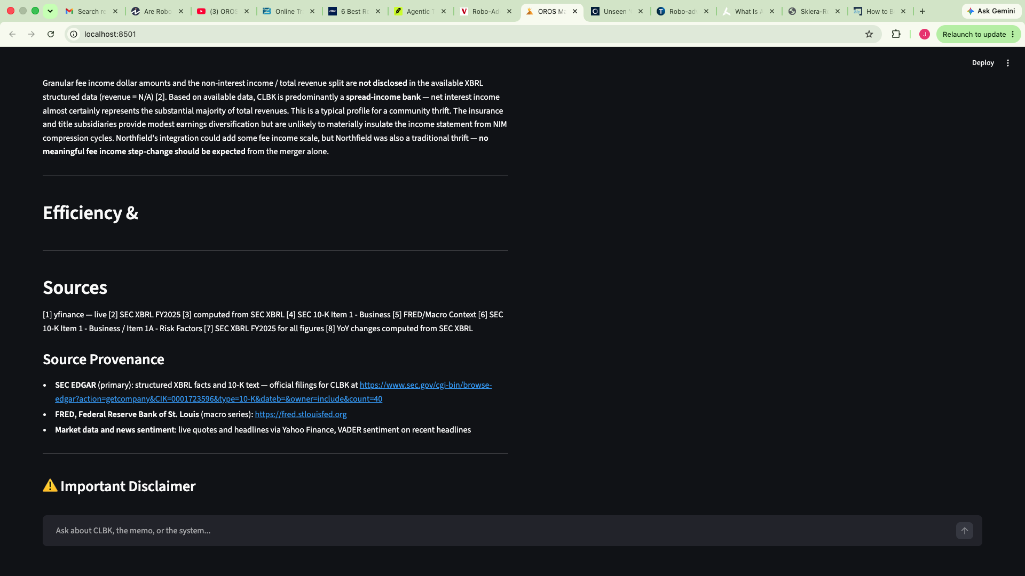
SECTION 5 · DATA SOURCES
Where Every Number Comes From — and the System Cites It Itself
STRUCTURED
SEC EDGAR — XBRL financial facts + 10-K filings (rate-limited, cached, compliant User-Agent) · Nasdaq Trader listings + SEC ticker map (~8,000 symbols → the OROS 500) · Yahoo Finance daily prices, whole universe, cached nightly · FRED macro series · VIX
UNSTRUCTURED
10-K text, chunked section-aware into a ChromaDB vector store (RAG: Items 1, 1A, 7) · news headlines scored by VADER sentiment (Alpha Vantage optional, quota-gated) · StockTwits social attention — the 'crowded' flag
STATED LIMITS
Free-tier quotes can lag 15+ minutes · fundamentals arrive on filing lag · news quotas fall back to VADER · strategy books inform priors — attribution only, no text reproduced
Every research memo ends like this: numbered footnotes, source provenance, and live SEC EDGAR links — written by the agents, per claim.
The provenance rule: no number is spoken on any surface that is not journaled first — and no claim appears in a memo without a footnote.
Primary sources: sec.gov/EDGAR · fred.stlouisfed.org · nasdaqtrader.com · Yahoo Finance · StockTwits · Alpha Vantage
OROS · Fordham MSAIB Capstone · simulated paper trading · educational, not financial advice
Notes:
50 seconds. Be factual and specific: structured financials come from SEC EDGAR's XBRL — never scraped PDFs — with a compliant User-Agent and rate limiting; the universe comes from Nasdaq Trader's own listing files; prices from Yahoo Finance cached nightly for all 500; macro from FRED. Unstructured: the 10-K text itself, chunked into a vector store respecting Item boundaries, plus VADER-scored headlines and StockTwits attention. Then point at the screenshot: the system writes its own bibliography — numbered footnotes and a live EDGAR link by CIK in every memo. State the limits before they ask: delayed quotes, filing lag, quota fallbacks.

Slide 8
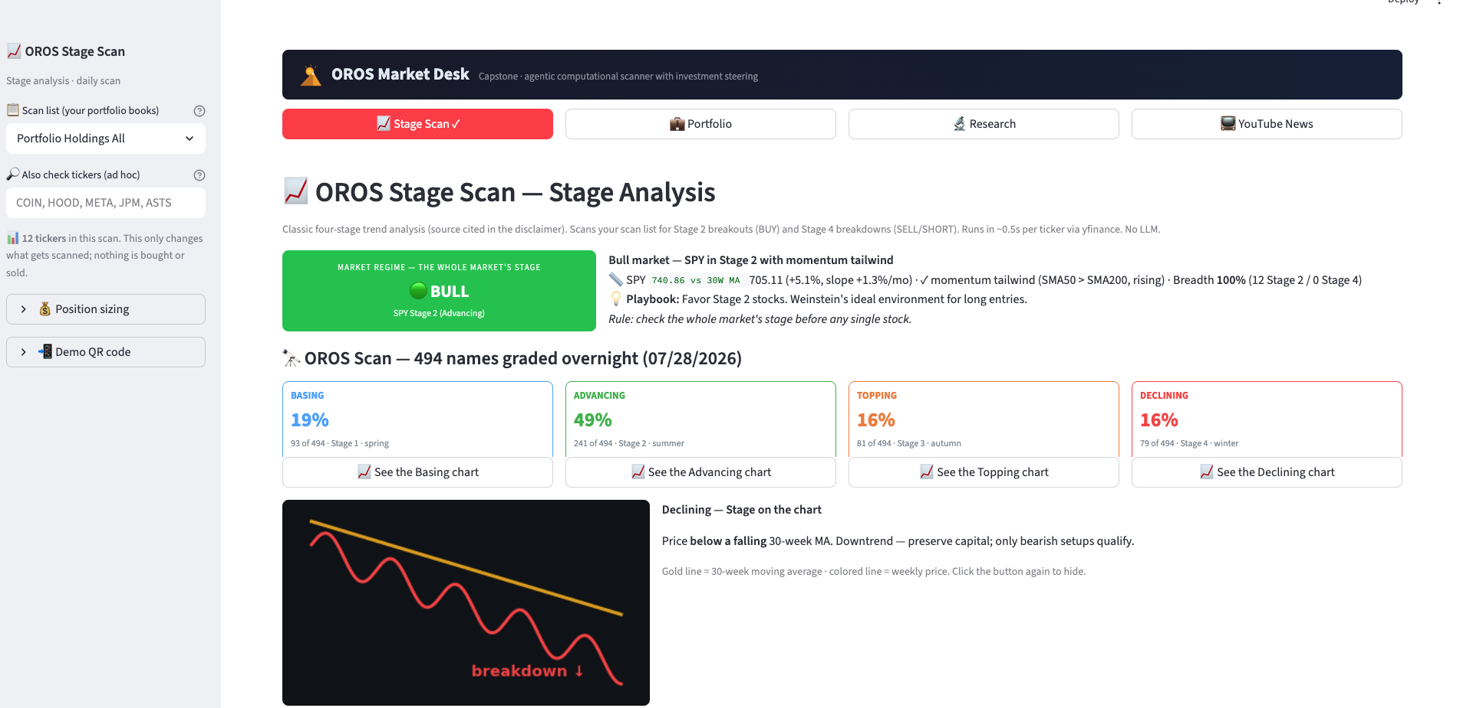
SECTION 6 · MVP — THE SCANNER
ScannerAgent: 494 Names Graded Overnight, Every Morning
The OROS 500 graded into four stages — clickable stage schematics, membership list, CSV export. Same figures the broadcast reports: one journal, three surfaces.
OROS · Fordham MSAIB Capstone · simulated paper trading · educational, not financial advice
Notes:
45 seconds. This is the landing screen: the whole market's weather, then your list's scan. Stage cards double as navigation. Emphasize the timestamped provenance — these figures came from the overnight autonomous run and match the video and the email.

Slide 9
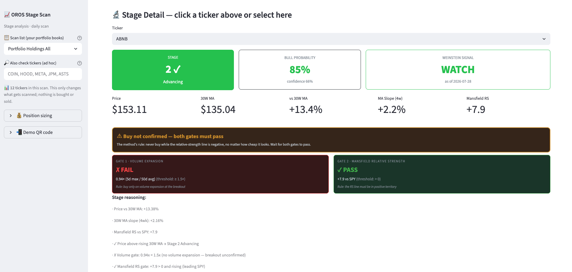
SECTION 6 · MVP — THE GATES
Discipline You Can Point At: Both Gates Must Pass
ABNB: Stage 2, bull probability 85% — and still not a BUY, because the volume gate failed. The system refuses good-looking names without proof of strength.
OROS · Fordham MSAIB Capstone · simulated paper trading · educational, not financial advice
Notes:
45 seconds. The money moment: an 85% bull-probability name REFUSED because volume hasn't confirmed. Read the two gate cards aloud — pass and fail. No entry without proof of strength; a WATCH label is the system practicing patience in public.

Slide 10
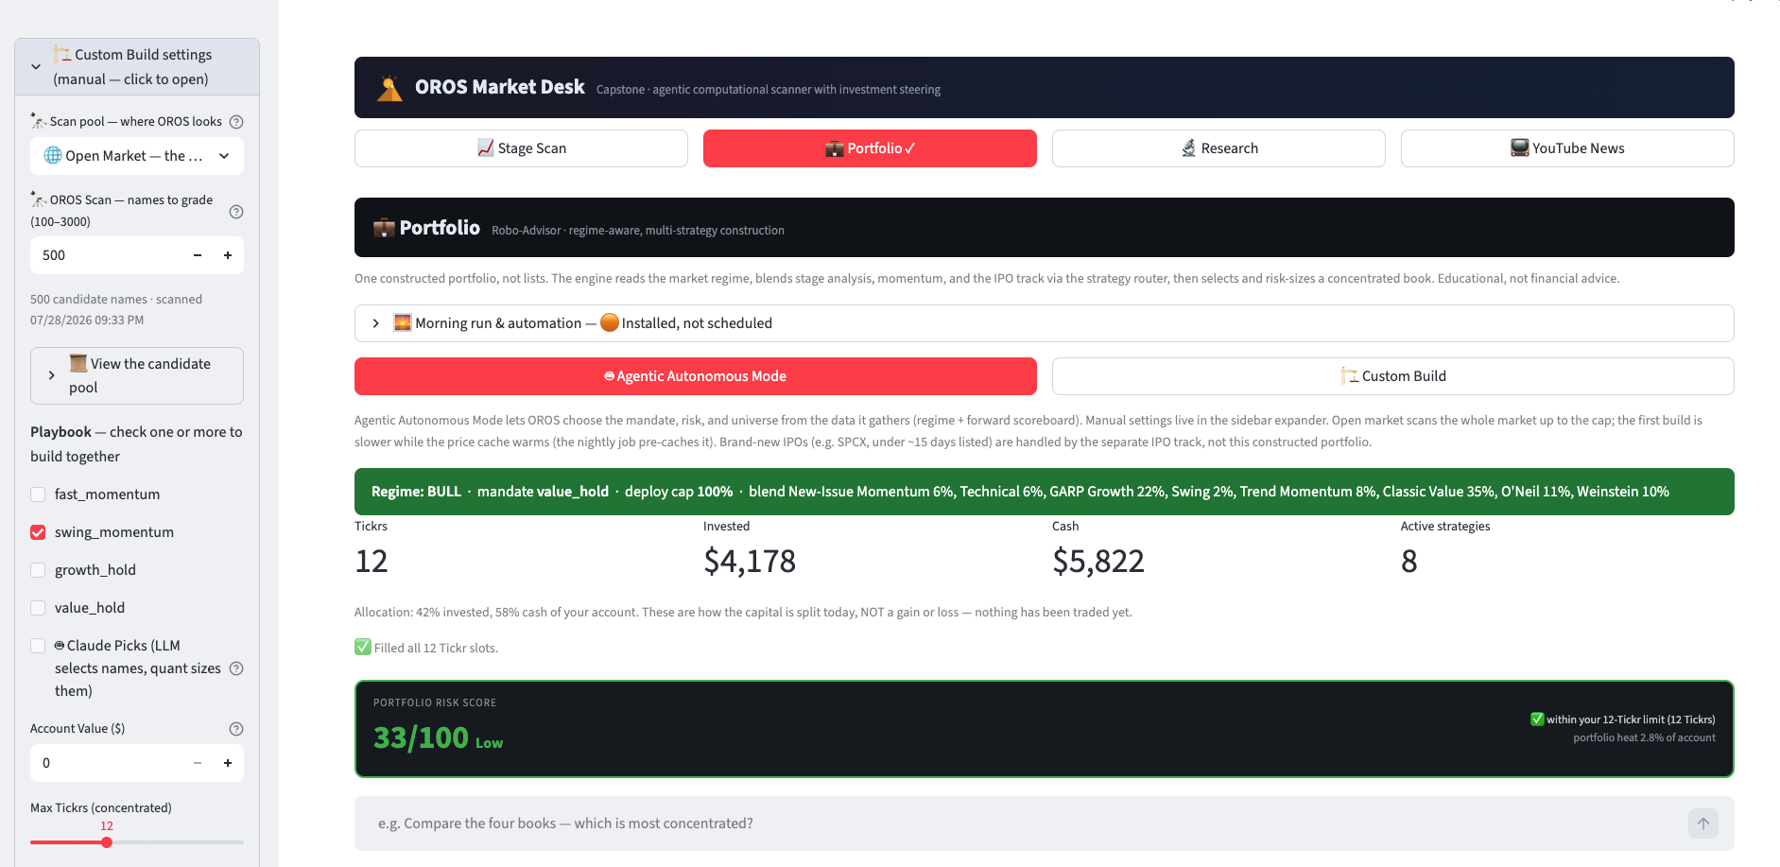
SECTION 6 · MVP — THE AGENTIC BUILD
Robo-Advisor · Regime-Aware, Multi-Strategy Construction
One click: regime read, blend chosen, 12 positions selected and risk-sized, 33/100 risk score — journaled, with the bench (excluded names + reasons) underneath.
OROS · Fordham MSAIB Capstone · simulated paper trading · educational, not financial advice
Notes:
50 seconds. Agentic Autonomous Mode: the system chose mandate, risk, and universe from data. Point at the blend banner (the Playbook), the risk score, and mention the bench — the journal of names it REFUSED, with reasons. Customization: check different Playbooks — sprinter, swing, patient growth, value — same rules, different personality.

Slide 11
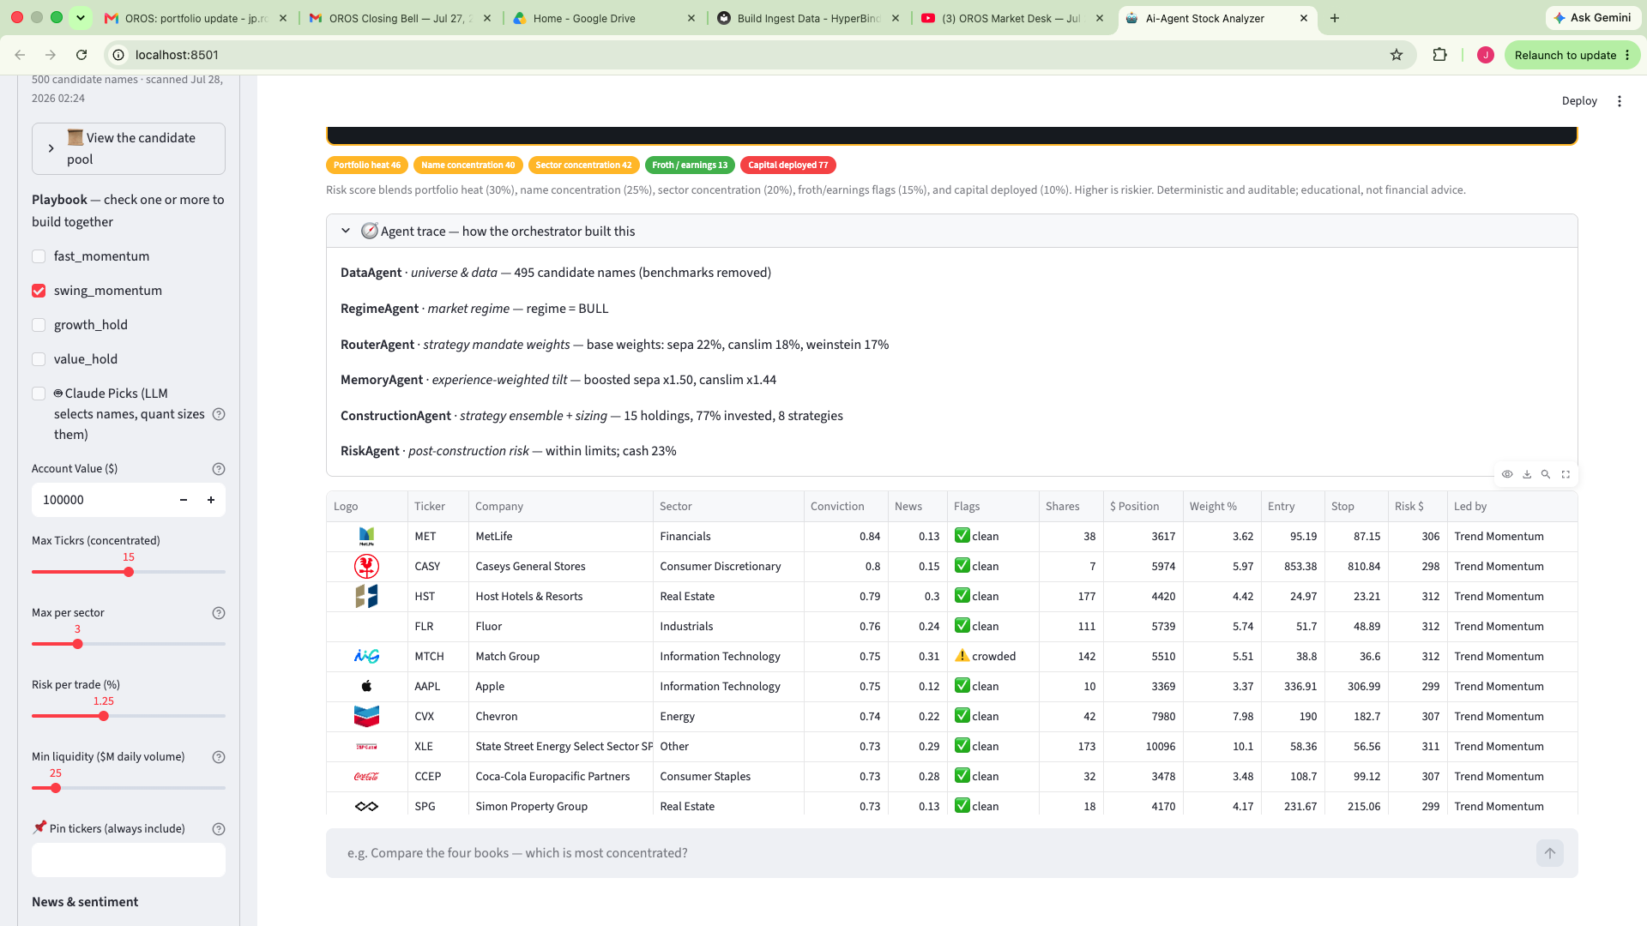
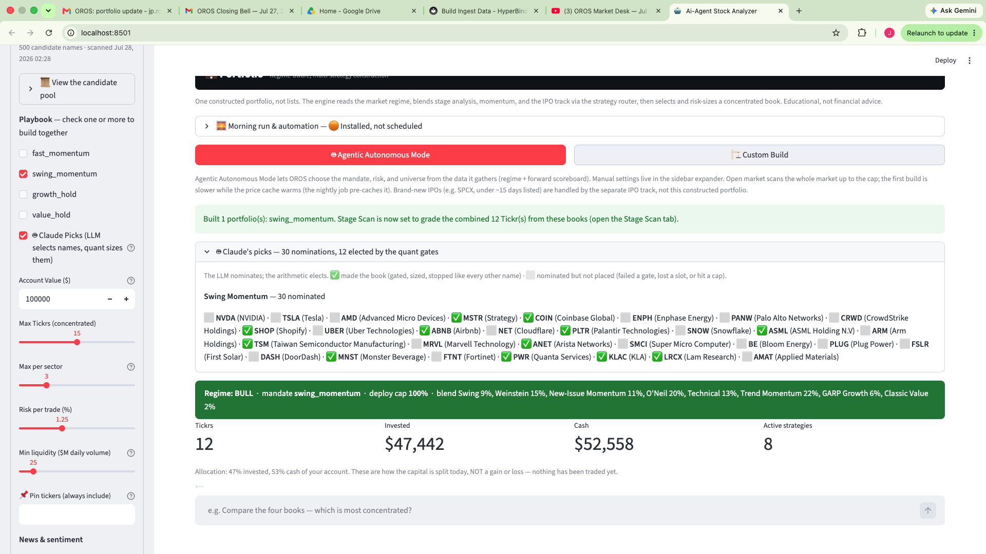
SECTION 6 · MVP — SAME MANDATE, TWO SCOUTS
“Claude Asked for NVIDIA. The Arithmetic Said No.”
Quant scout: 15 boring, diversified holdings — 77% deployed.
Claude scout: 30 famous nominations — the gates elected 12, held 53% cash.
The LLM contributes salience — it knows what the world is excited about. The quant layer prices that excitement. The book is the intersection; the cash is the disagreement, quantified.
OROS · Fordham MSAIB Capstone · simulated paper trading · educational, not financial advice
Notes:
55 seconds. Built live the night before this presentation, and it reruns live in the demo. Claude nominated NVIDIA, Tesla, AMD; the deterministic gates refused all three and sized the 12 survivors so cautiously the book held 53% cash. The audition sheet shows every nomination with its verdict — the safety architecture made visible.

Slide 12
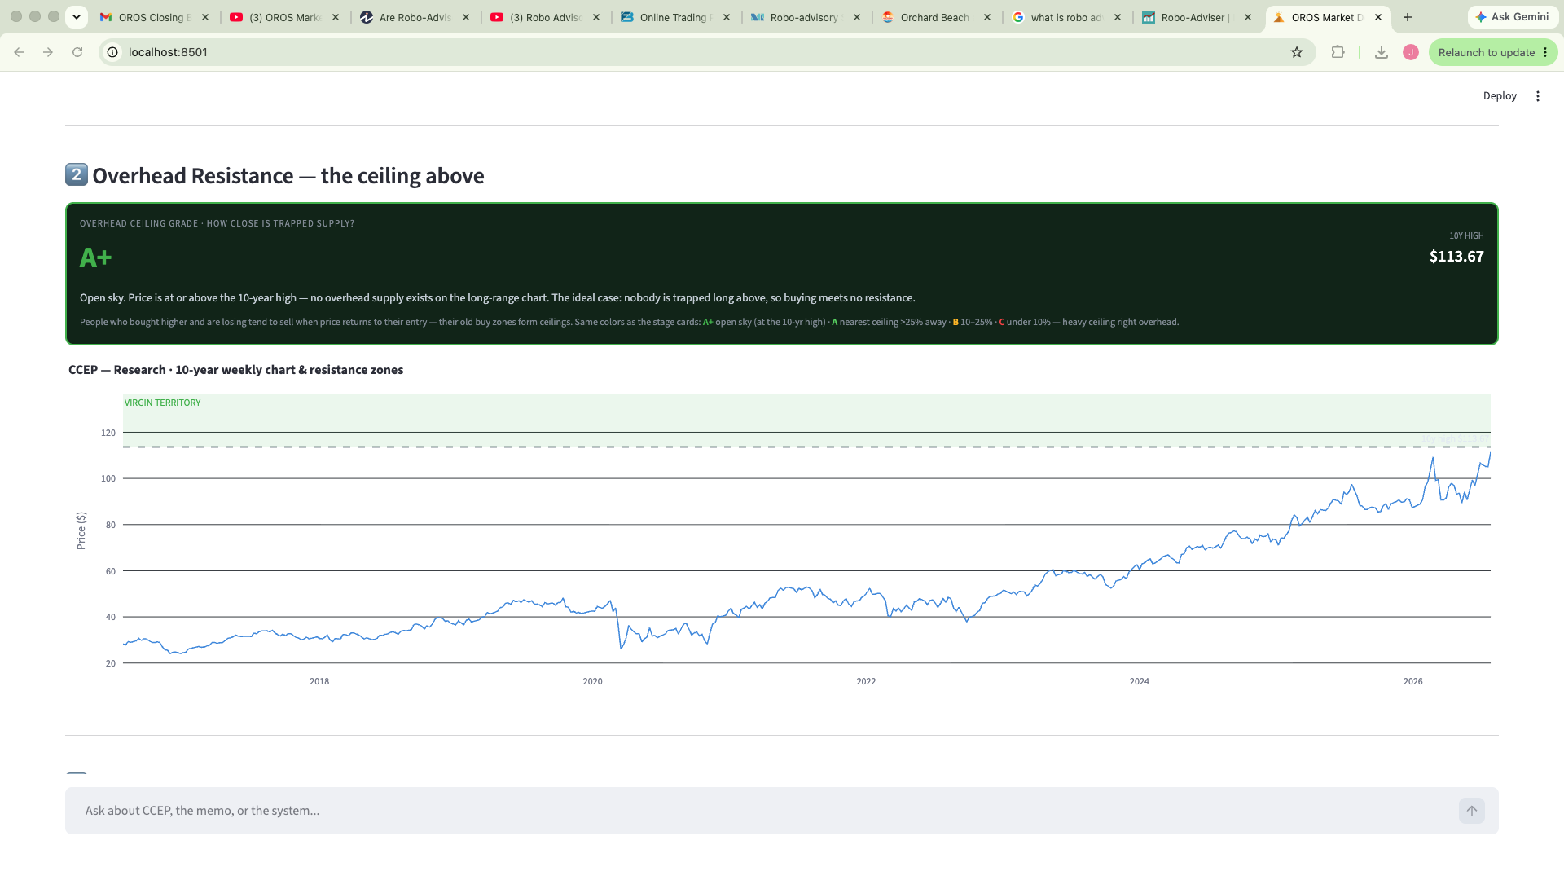
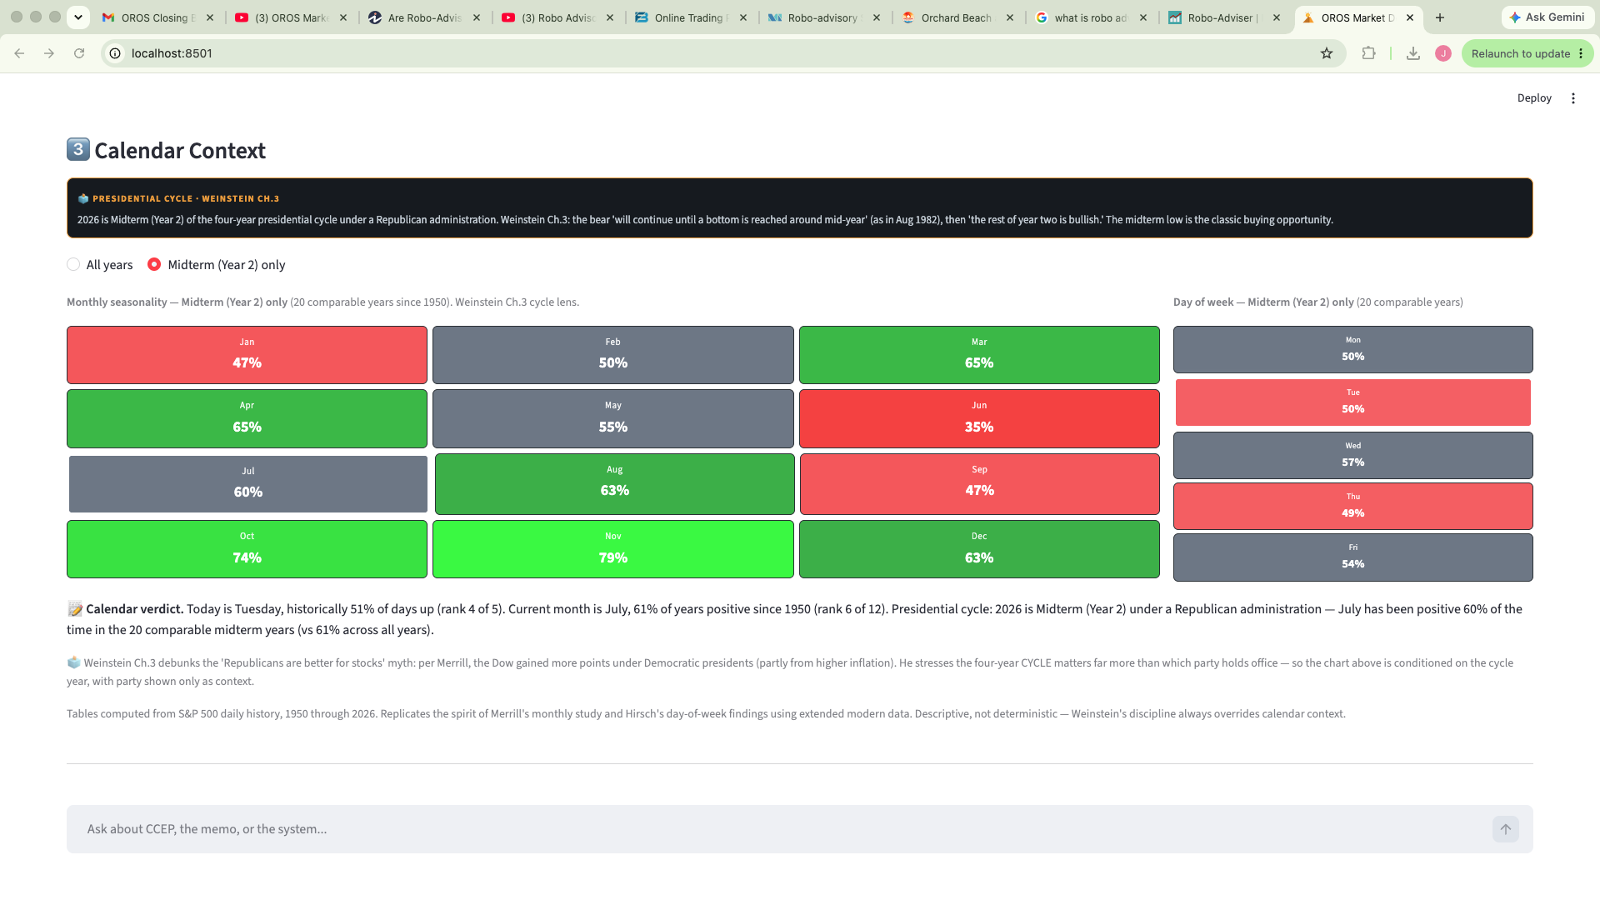
SECTION 6 · MVP — THE HISTORIAN
Ten Years of Context Makes Strange Days Announce Themselves
Overhead resistance graded A+ — ten years of price history locate every ceiling of trapped supply.
Calendar context: 46 years of seasonality — including the presidential-cycle read for 2026.
When today breaks from a decade of normal, the outlier is visible — the Historian is how a scanner earns the word 'research'.
OROS · Fordham MSAIB Capstone · simulated paper trading · educational, not financial advice
Notes:
40 seconds. The Research tab's Historian: overhead supply zones from ten years of price, seasonality from 46 years of calendar. This is the EDA layer — anomaly detection by context. Mention: every claim in the memo cites SEC filings.

Slide 13
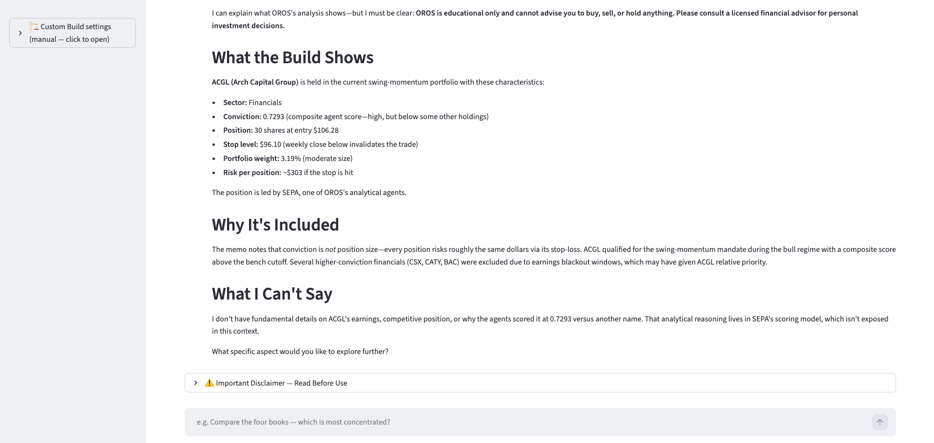
SECTION 6 · MVP — THE CONVERSATION
The Personalization Gap, Answered: An Advisor You Can Question
Ask OROS explains its own build — and draws its own line: 'What I Can't Say.'
Robo-advisors ask you five questions once. OROS answers yours every day — and knows what it must not answer.
OROS · Fordham MSAIB Capstone · simulated paper trading · educational, not financial advice
Notes:
50 seconds. The direct answer to Investopedia's 'lack of human touch.' Read the three headers aloud — What the Build Shows, Why It's Included, What I Can't Say. The refusal is the feature: educational conversation with enforced limits, in the Portfolio tab, the Historian, and the YouTube desk.

Slide 14
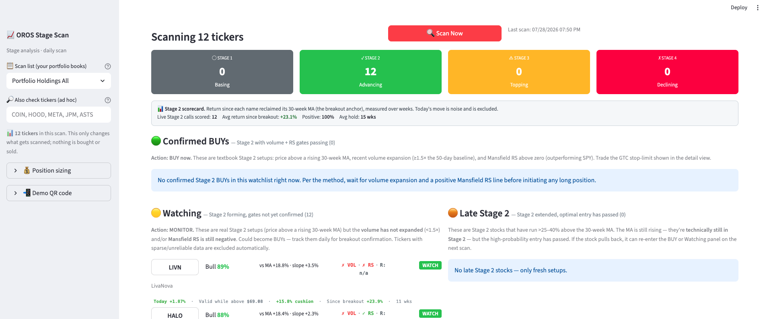
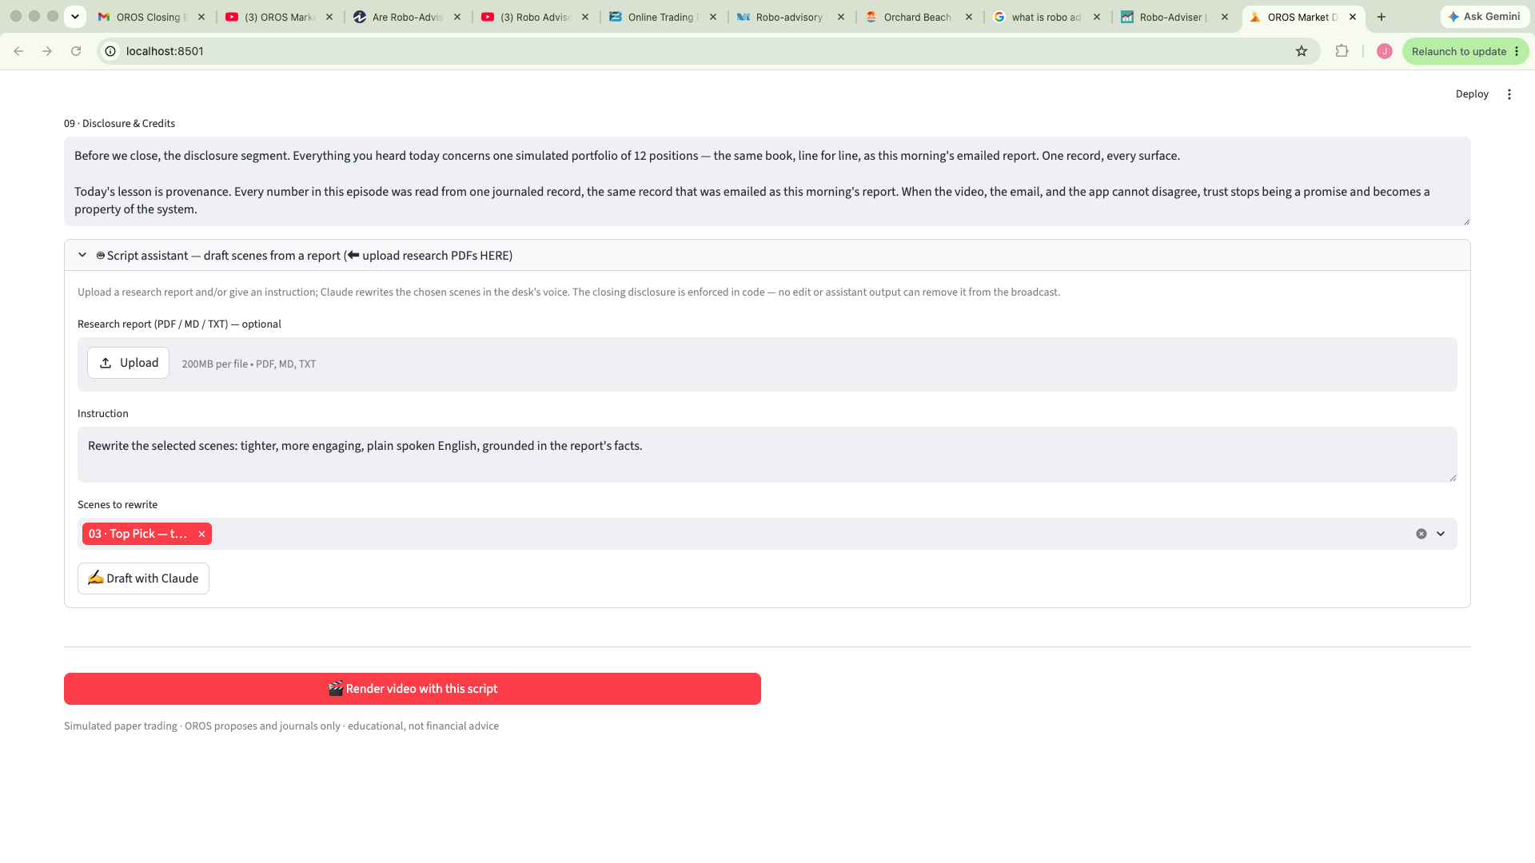
SECTION 6 · MVP — THE DAILY REPORT
One Email a Day: the Report the Video Must Match
The live scan panels — Confirmed BUYs, Watching, Late Stage 2 — feed the build…
…and the sign-off says the law: 'the same book, line for line, as this morning's emailed report.'
The uniformity rule, enforced in code: the diff is computed once and journaled; the report, the digest, the app, and the broadcast all read that one record. They cannot disagree.
OROS · Fordham MSAIB Capstone · simulated paper trading · educational, not financial advice
Notes:
45 seconds. Every surface derives from one journaled record — the report PDF, Nathan's glance digest, the app landing view, and both broadcasts. Say it as the trust property: they cannot disagree, by construction. Mention the research memo of the day rides along, SEC-cited.

Slide 15
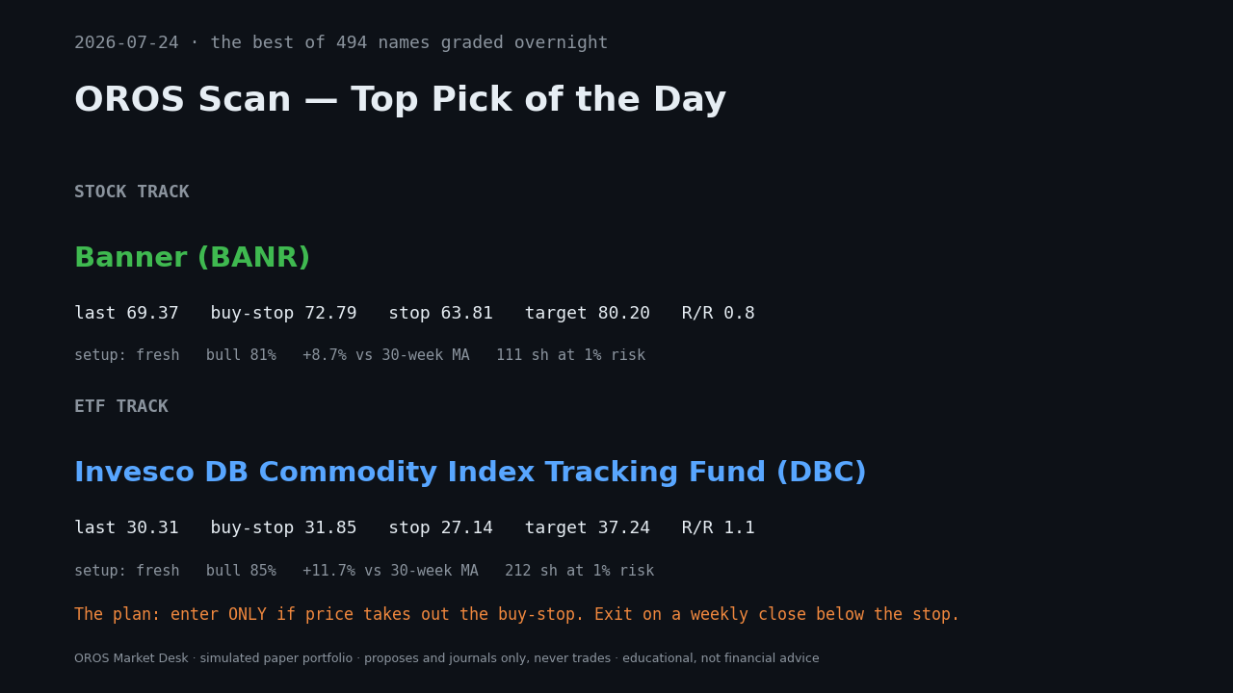
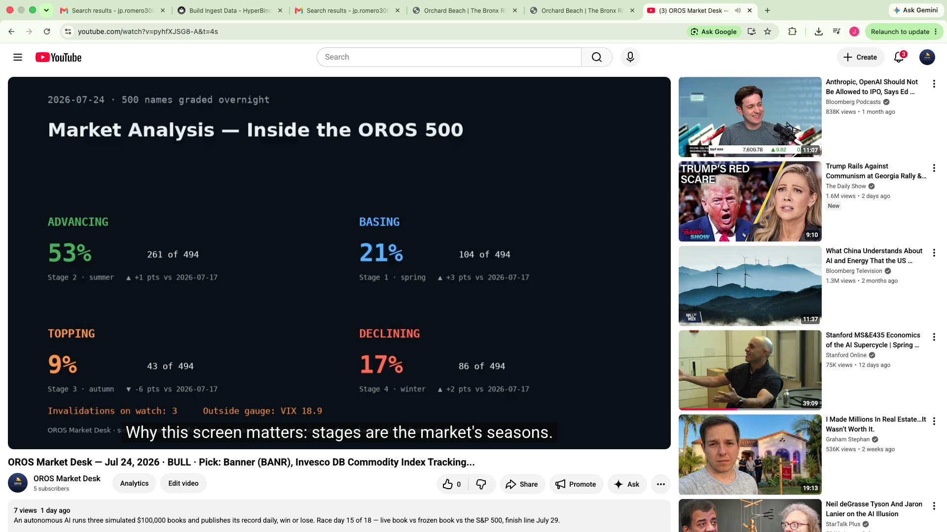
SECTION 6 · MVP — THE BROADCAST
Two Shows a Day, Fully Autonomous, Timestamped Forever
…published to YouTube by the pipeline itself: three AI voices, captions, chapters.
Morning Desk proposes: the Top Pick with its full trade plan in plain language…
The channel is a lab notebook the public can audit: wins, losses, and 'no pick today' — all in the same voice, no edits, no deletions.
OROS · Fordham MSAIB Capstone · simulated paper trading · educational, not financial advice
Notes:
45 seconds. GitHub Actions runs the desk twice daily: scan, build, render, voice, publish, email, journal — laptop closed. Tonight's episode aired the corrected classifier and the holdings scene. Play 20 seconds of today's episode here if time allows.

Slide 16
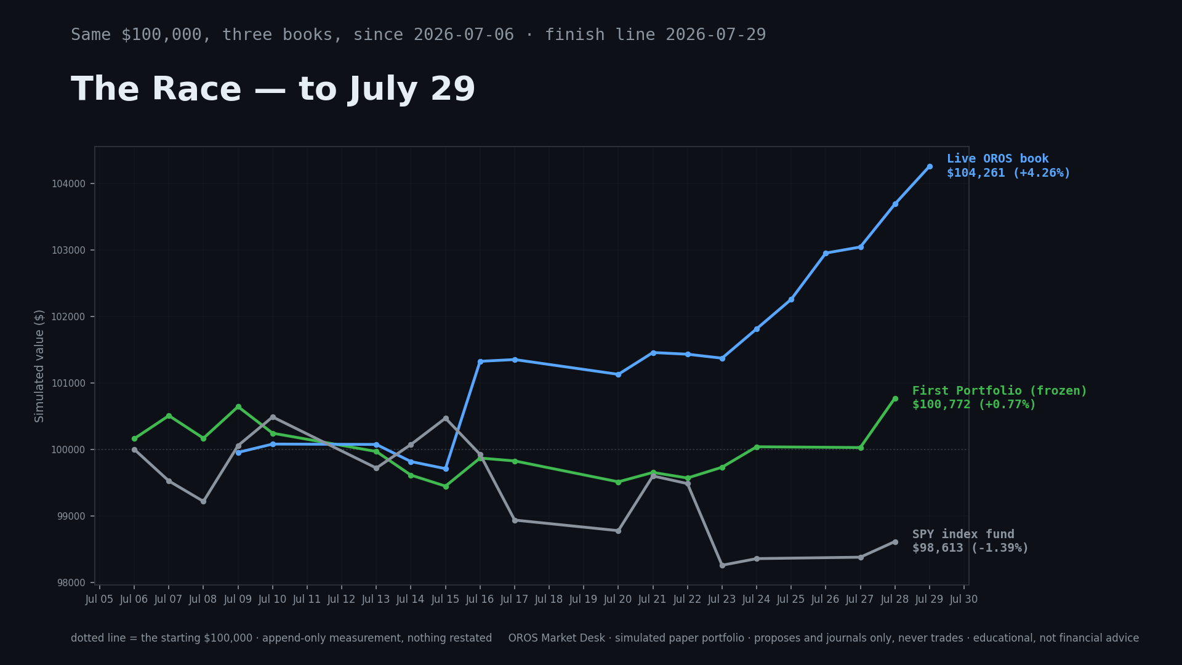
SECTION 6 · MVP — PERFORMANCE, JOURNALED
The Race to July 29 — Append-Only, Nothing Restated
+3.98%
Live OROS book — $103,977 (7/29 report)
+0.60%
First Portfolio, frozen — $100,602
−1.39%
SPY, same $100,000 — $98,613
17 sessions, one bull regime — this claims process integrity, not alpha. And the audit story: we found our own diff bug (48 phantom mentions), quantified it, fixed it, journaled it.
OROS · Fordham MSAIB Capstone · simulated paper trading · educational, not financial advice
Notes:
60 seconds. The honest forward chart — every point journaled, finish line on presentation day. Say the caveat before they do: 17 sessions in one regime proves process, not alpha. Then the audit: we read our own reports skeptically, found phantom drops, fixed and published. Self-grading includes the plumbing.

Slide 17
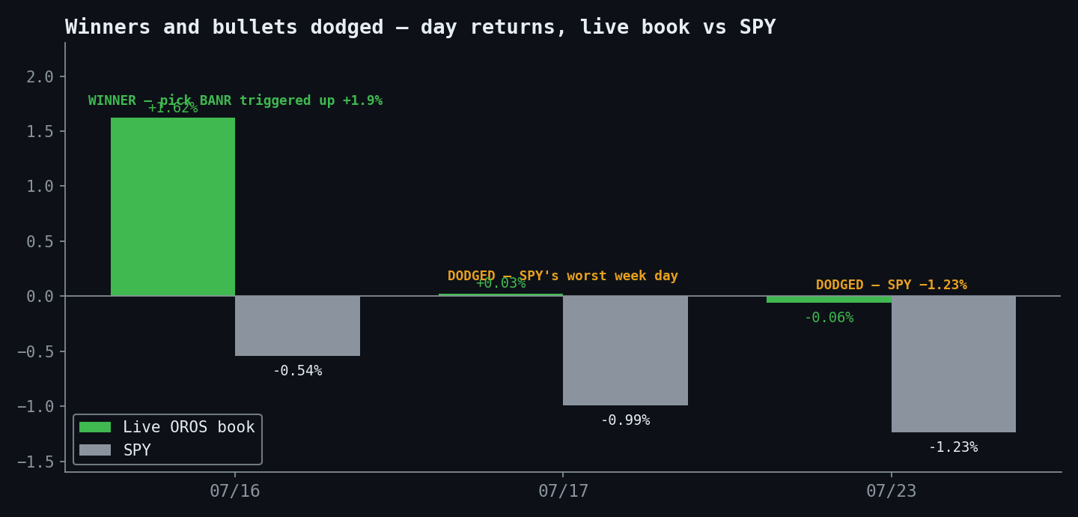
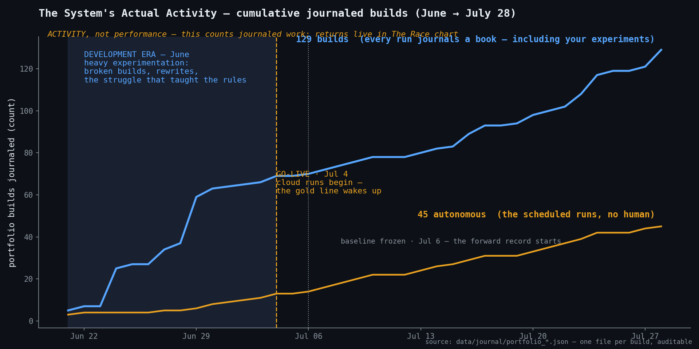
SECTION 6 · MVP — DEFENSE & PROVENANCE
Bullets Dodged, and the Machine's Heartbeat
129 journaled builds since June: blue = development struggle; gold = the autonomous cadence.
On SPY's two worst days the book sat nearly flat; on the BANR day it ran +1.62%.
June was hard and the chart says so — the struggle taught the rules. After go-live, the gold line never misses a day.
OROS · Fordham MSAIB Capstone · simulated paper trading · educational, not financial advice
Notes:
45 seconds. Left: defense — the days the system refused to lose. Right: the biography chart — development era shaded honestly, go-live, then the machine's daily heartbeat. Every point on both charts is a JSON file I can open live.

Slide 18
SECTION 7 · MARKET & PROJECTED VALUE
A Small Player in a $49 Billion Ocean
$0.70
$27,660
$49.2B
July's journaled LLM spend — the system tracks its own bill (~$23/mo all-in)
one Bloomberg seat/yr — OROS runs a year for ~1% of that
2025 market-data spend (Burton-Taylor) + robo growing 29.6%/yr
Scenario, not forecast: at TradingView-style $24/mo — 1,000 subscribers = $288K ARR at 90%+ margins; 10,000 (~1% of TradingView's paying base) = $2.9M ARR. TradingView's ~$173M revenue proves retail pays for analysis tools.
Positioning: not Bloomberg's 325,000 seats — the tens of millions Bloomberg ignores. In that wedge the differentiator is trust: a public, timestamped, self-graded record. Closest category: robo-advisory — OROS is its agentic, transparent next generation.
Sources: marketsmedia.com (Burton-Taylor) · wallstreetprep.com terminal pricing · getlatka.com/tradingview · mordorintelligence.com · fortunebusinessinsights.com
OROS · Fordham MSAIB Capstone · simulated paper trading · educational, not financial advice
Notes:
55 seconds. Lead with the seventy cents — the number nobody expects, and it is journaled, not estimated. One Bloomberg seat costs 100x OROS's whole year. The scenario is labeled scenario; the margins are evidence because the cost line is real.

Slide 19
SECTION 8 · LIMITATIONS & ONGOING RESEARCH
Four Open Questions, Researched in Public
1 · Statistical significance
17 sessions, one regime — no inference claimed. The record accumulates daily by design.
2 · No backtest — deliberately
Forward-only avoids look-ahead and survivorship bias. Journaled before the open, graded at the close.
3 · Ablation & classifier study
Which agent earns its keep? Two classifier fixes came from human review THIS WEEK — encoded within hours. The meta-model is this study.
4 · Cost realism
Paper fills flatter results. Broker-verified paper (Alpaca) is roadmap item one. Real robo-advisers are SEC/FINRA-regulated; OROS deliberately is not — it proposes, journals, and never trades.
OROS · Fordham MSAIB Capstone · simulated paper trading · educational, not financial advice
Notes:
60 seconds. Say each limitation before they can — every one ships with its study design. Number 3 is the pride point: BND and HOOD were both re-classified this week because a human questioned the label and the framework's own logic settled it. That is how an autonomous system improves.

Slide 20
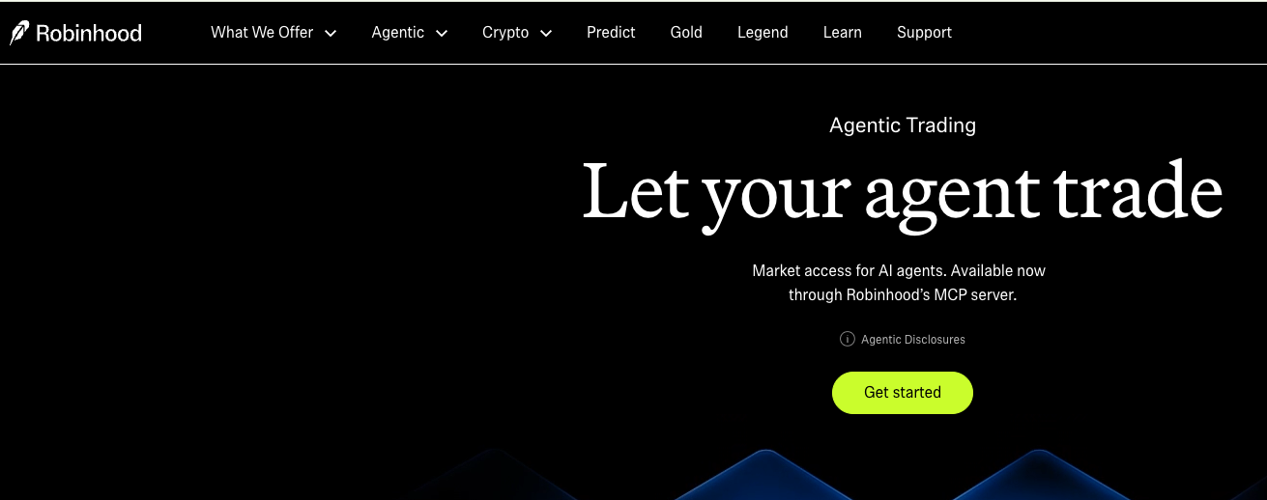
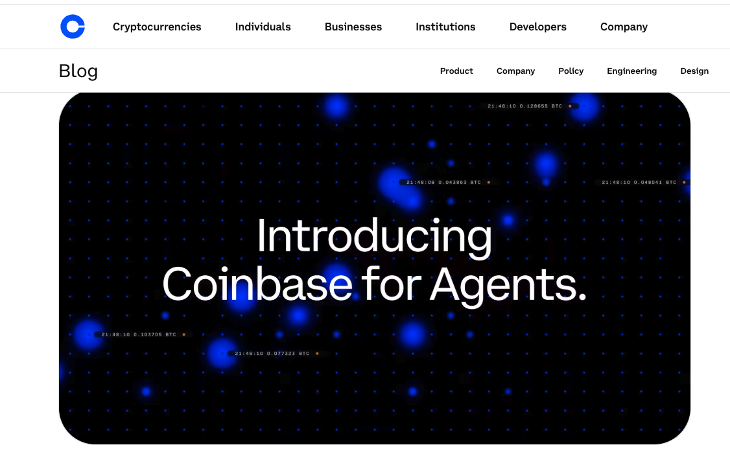
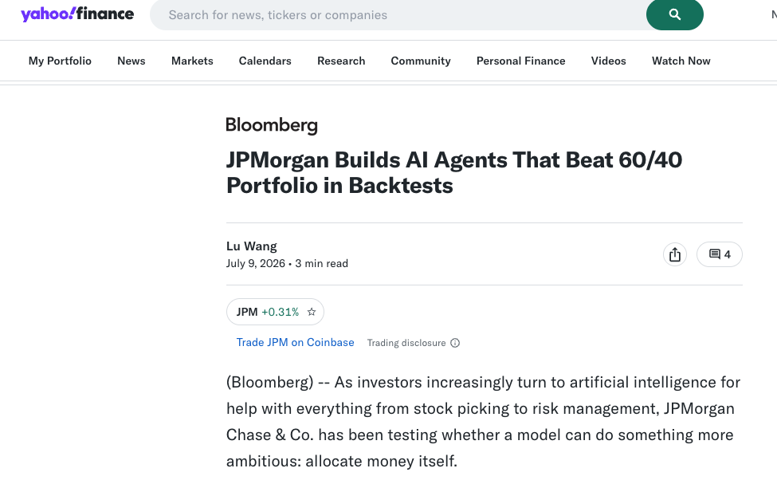
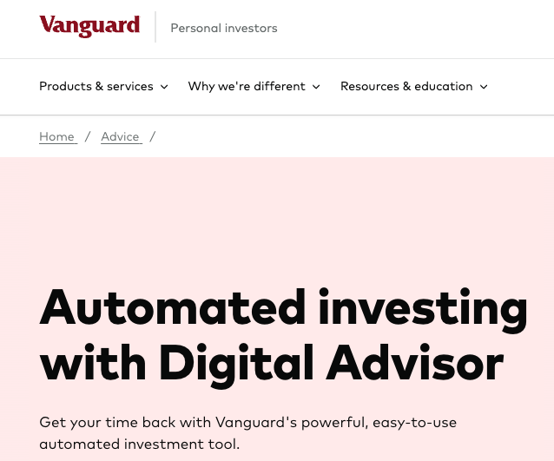
SECTION 9 · FUTURE ENHANCEMENTS
The Industry Is Laying the Rails — OROS Builds the Community on Them
Robinhood: 'Let your agent trade' — market access for AI agents via an MCP server
Coinbase for Agents — agent-native access
OROS'S NEXT STEPS
Bring-your-own portfolio (PNG/PDF/manual — OROS grades YOUR book) · broker-verified paper fills via agent-ready APIs (Alpaca; Robinhood MCP is exactly this rail) · the meta-model · tutorial episodes — and a community that learns in public: open journals, a channel that answers comments, students auditing the record
Bloomberg: JPMorgan's agents beat the 60/40 (Jul 2026)
Vanguard — robo at giant scale
When Robinhood ships agent market access and JPMorgan's agents beat the 60/40, the category is no longer speculative — the differentiator left is trust, and community is how trust compounds.
OROS · Fordham MSAIB Capstone · simulated paper trading · educational, not financial advice
Notes:
60 seconds. Walk the evidence: Robinhood is shipping 'Let your agent trade' through an MCP server — the exact rail a system like OROS would plug into for broker-verified execution; Coinbase built agent-native access; JPMorgan — the same bank from our course case — has agents beating the 60/40 in backtests as of July 2026; Vanguard runs robo at giant scale. The rails exist. OROS's roadmap rides them — bring-your-own portfolio first, then agent-API paper fills — and adds the thing none of these ship: a community that learns in public, open journals, a channel that grades itself. Trust compounds socially; that is section nine.

Slide 21
SECTION 10 · CONCLUSIONS & TAKEAWAY
What This Capstone Demonstrates
1 · Navigating Extreme Market Volatility
Regime-aware exposure and journaled exits kept the live book nearly flat on SPY's worst days — cash treated as a decision, never leftovers.
2 · Democratizing Institutional-Grade Strategies
A 31-agent research desk running published, peer-reviewed strategy families — for roughly $23 a month instead of a $27,660 terminal seat.
3 · Scaling Operational Efficiency
One student, zero hands on the keyboard: 45 autonomous builds, two broadcasts a day, and one journaled record that every surface must match.
4 · Overcoming Legacy Software Limitations
Where robo-advisors are static questionnaires, OROS converses, explains, grades itself — and encodes a human correction within hours.
“I see a future where everyone has a financial advisor — and public markets earn the trust we grant gold and oil. OROS is one student-sized step toward that.”
“The system proposes; it never trades. The record is public — win or lose.” — thank you · OROS Market Desk on YouTube · journals open for review
Notes:
60 seconds, slow. Four conclusions, one line of evidence each: volatility — the flat book on SPY's worst days; democratization — institutional discipline at 1% of a terminal seat; efficiency — 45 autonomous builds and two daily shows with no hands; legacy — the advisor that converses and self-corrects within hours. Then your statement, slowly — it is the emotional center. End on the end-card quote, thank Professors Zhou, Ettl, and Tang, and invite the quant review: the journals are open.

